Slide 1
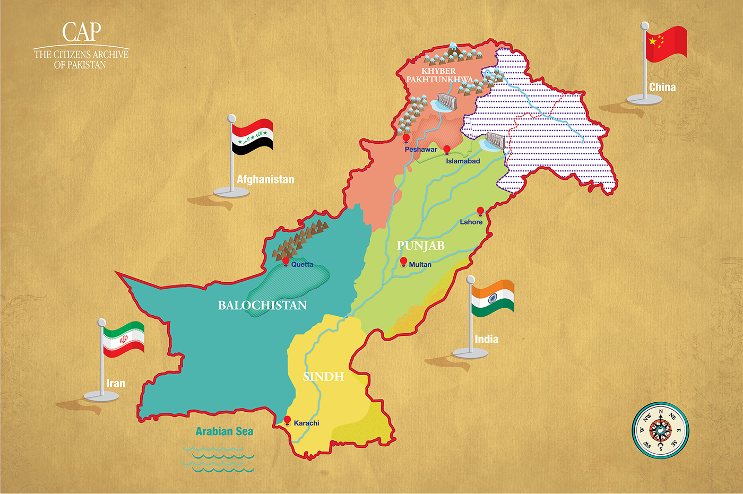
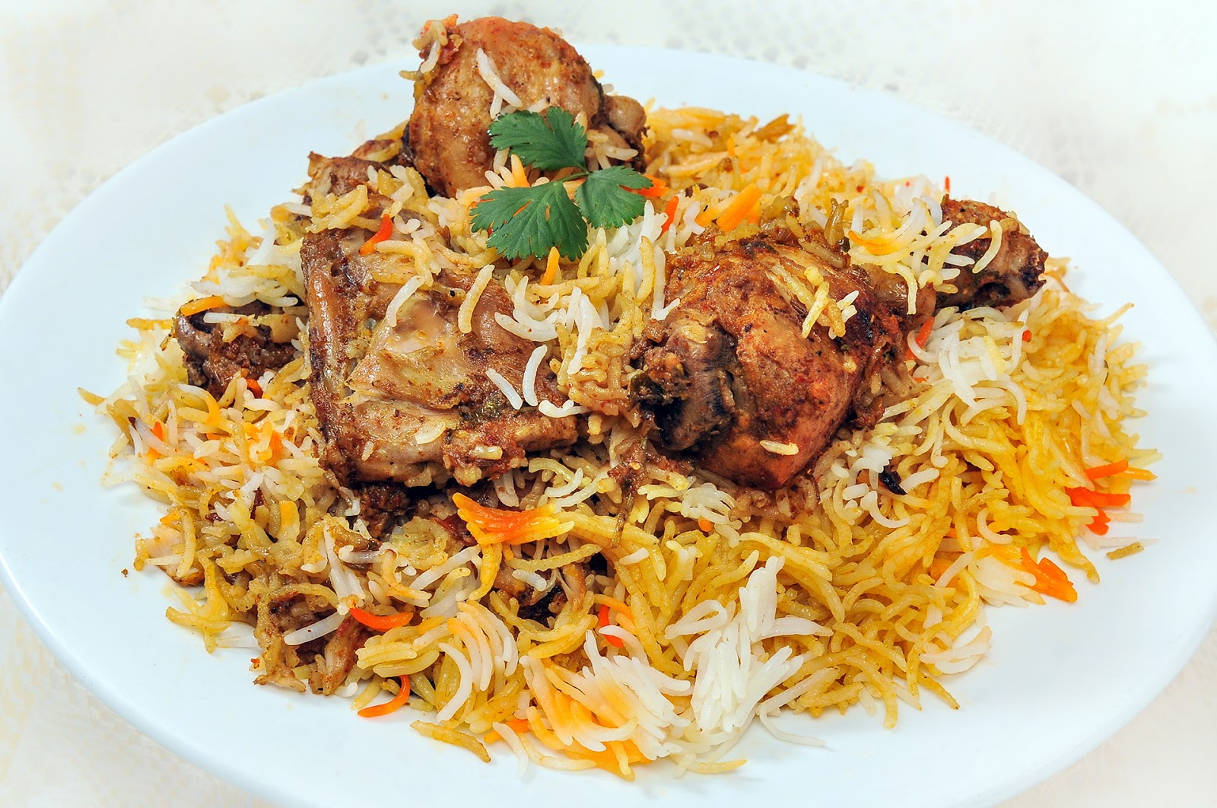
Ahafeez7
Look at the most popular dishes in each province !
SINDH

Slide 2
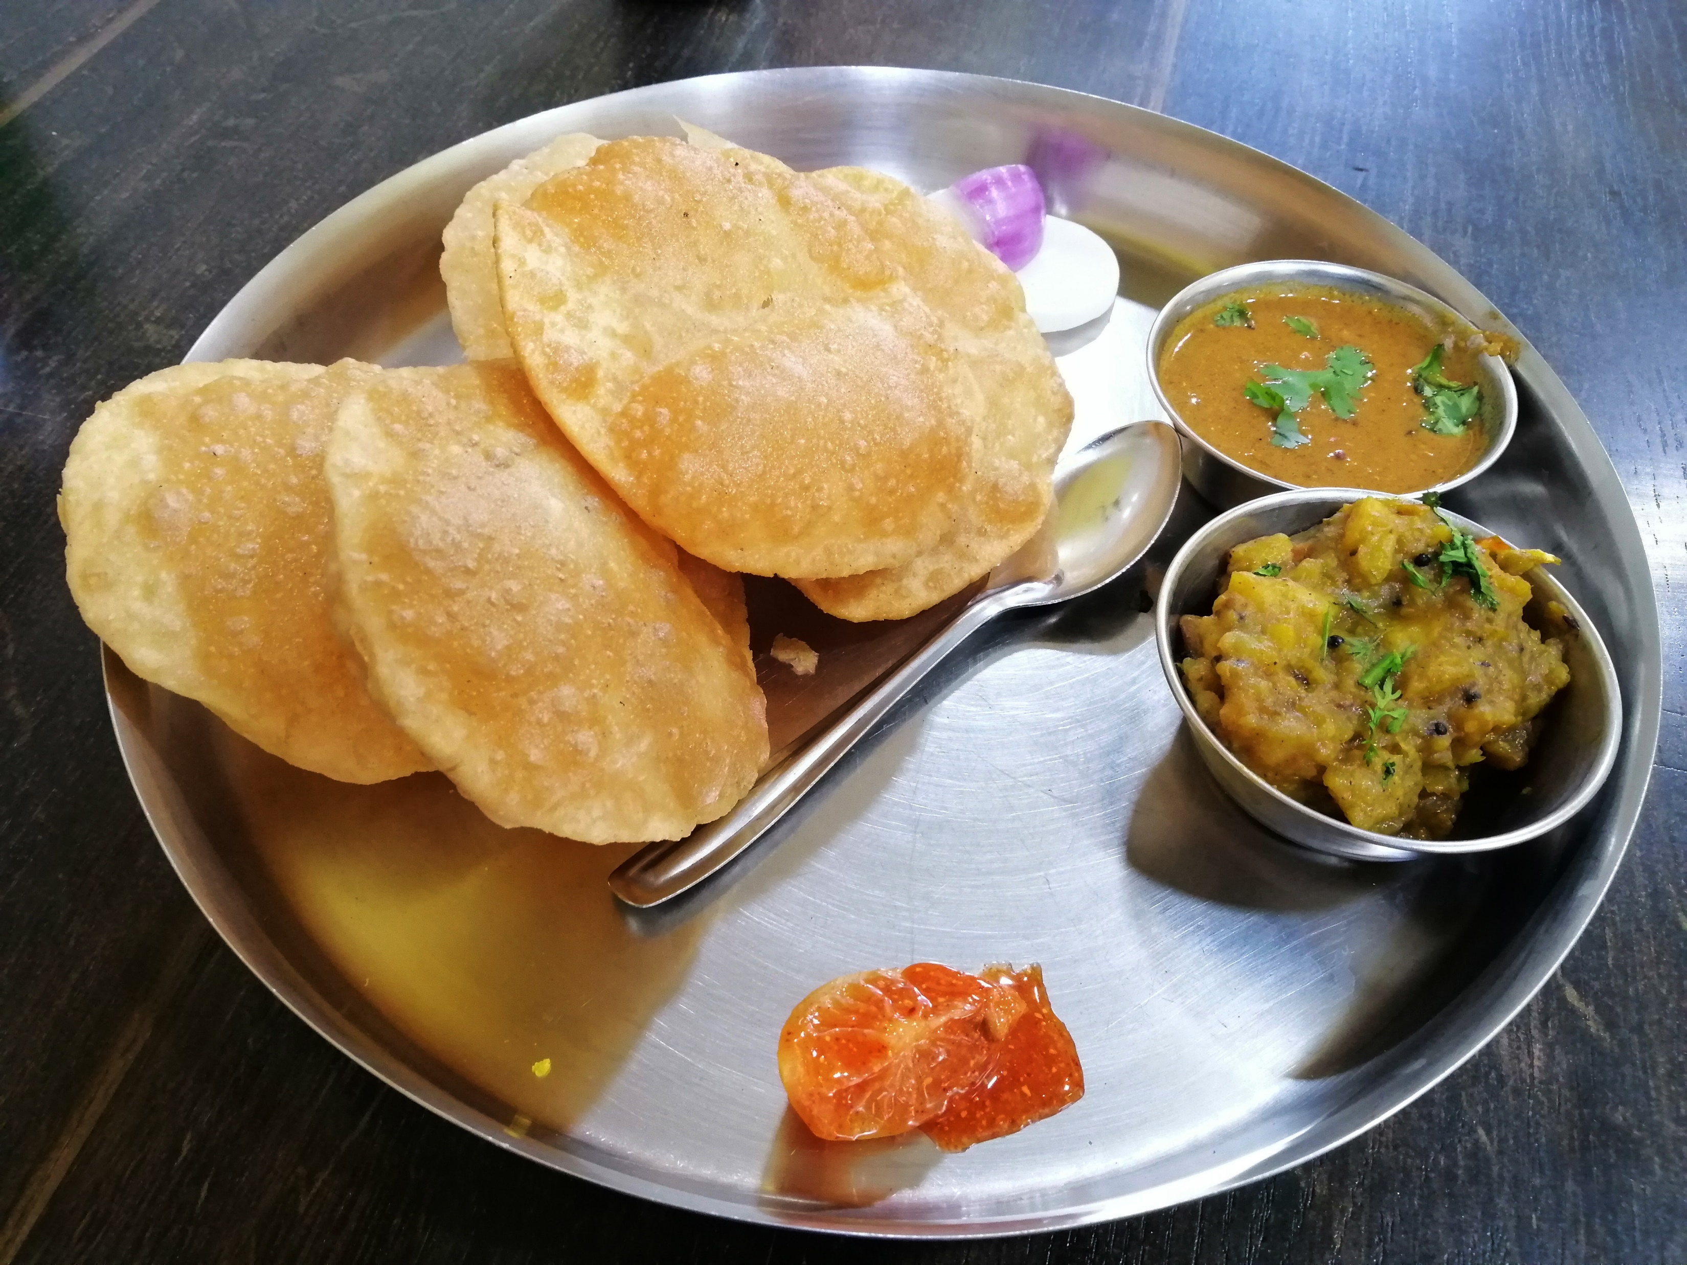
Ahafeez7
Punjab

Slide 3
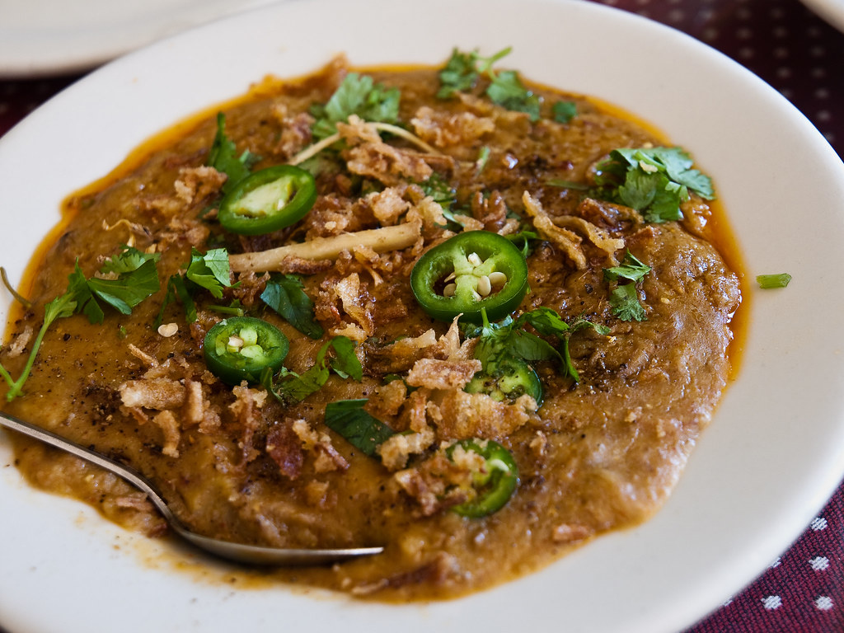
Ahafeez7
Balochistan

